Slide 1

ADVISOR
STUDENT
Dr. Eng. Dhany Arifianto, ST., M.Eng
Muhamad Haykal Hanif Gifari Adi
02311940000154
Designing and Infrasound-based Early Warning System for Merapi Volcano

Slide 2



I
Timeline
No | Kegiatan | Bulan ke-1 |  |  |  | Bulan ke-2 |  |  |  | Bulan ke-3 |  |  |  | Bulan ke-4
 |  | 1 | 2 | 3 | 4 | 1 | 2 | 3 | 4 | 1 | 2 | 3 | 4 | 1 | 2 | 3 | 4
1. | Data Ingestion
2. | Data Exploration and Understanding
3. | Data Pre-Processing and Feature Engineering
4. | Model Building and Selection
5. | Model Deployment
6. | Forecasting Solution Acceptance
7. | Report Writing

Slide 3
I
Data Ingestion
Data Timeline

Slide 4
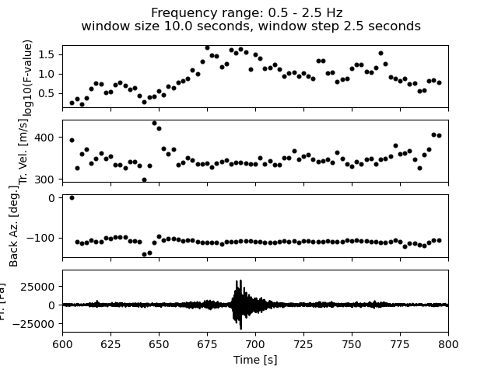
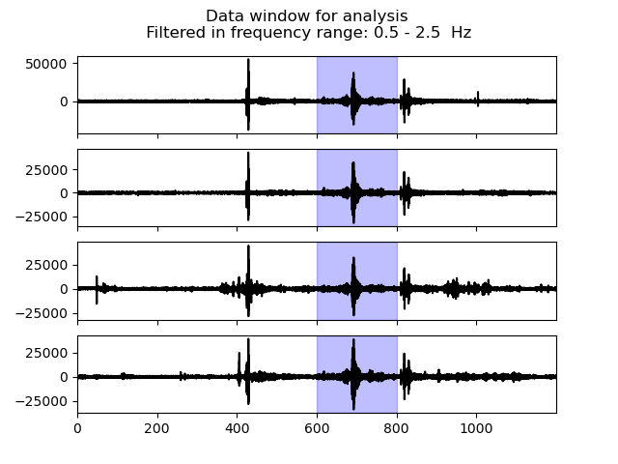
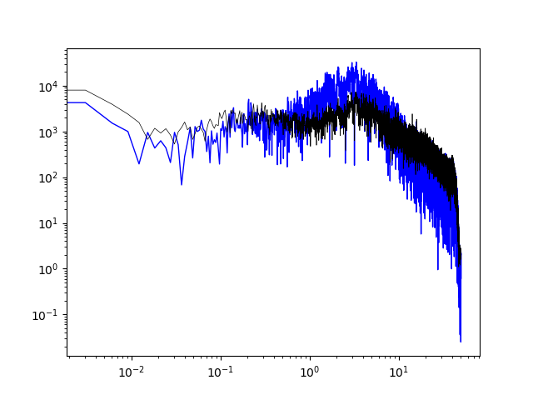
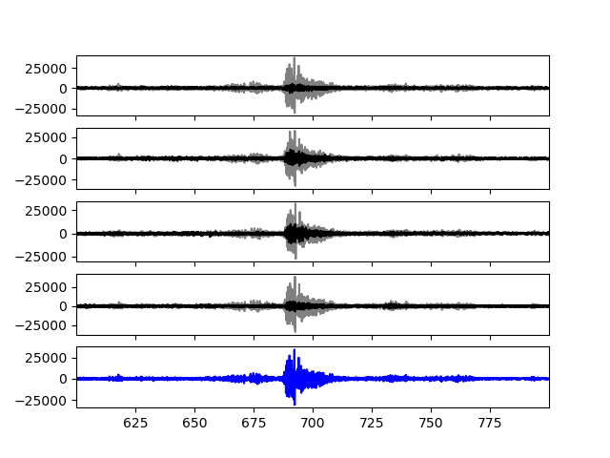
IV
Data Preprocessing
Detection & Beamforming
Results:
Detection Time(s)
Back Azimuth(s)
Trace Velocity
Array ID

Slide 5
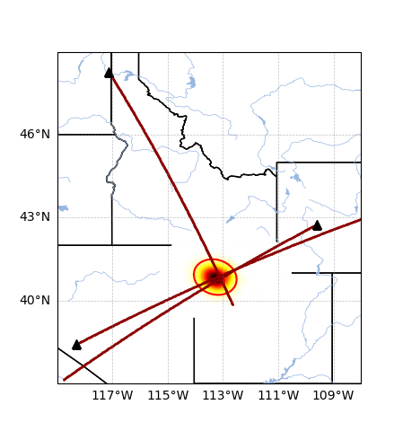
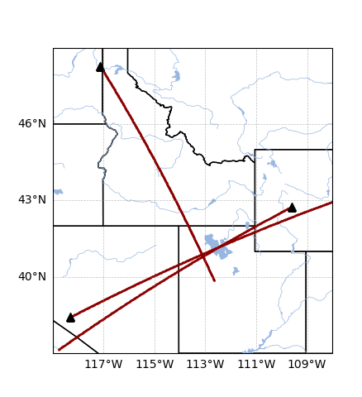
IV
Data Preprocessing
Association
Results:
Spatial and temporal PDFs
Maximum Posteriori Solution
20 Normal approximation of Spatial PSD

Slide 6
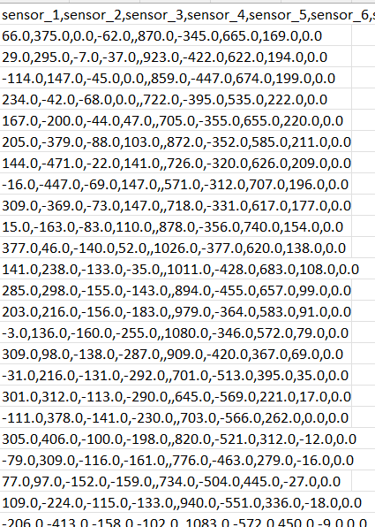
IV
Data Preprocessing
Feature Engineering
10 segments, 53 features that would be used for the model
Temporal characteristics: mean, var, amplitude, quantiles, rolling gradient amplitude, number of peaks (using tsfresh), autocorrelation, zeros-cross rate
Frequential features: mean/var/amplitude of imaginary and real parts of Fourier Transform.
Cepstral features: Mel-frequency cepstral coefficients (20 coeff)
Spectral features: the spectral_contrast (7 coefficients)
All these features were calculated for each sensor (missing values set to -1) and saved as csv locally (90min to run for train + test sets).

Slide 7
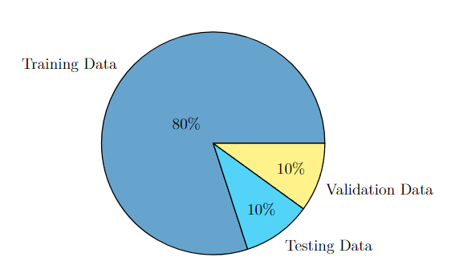
IV
Data Preprocessing
Data Splitting

Slide 8
IV
Model Building
Decision Tree
Neural Network Model
model = LGBMRegressor
learning_rate': 0.2685684371804056
'boosting_type': 'dart’
'objective': 'regression’
'metric': 'mae’,
'sub_feature’: 0.6191142906653122,
'num_leaves': 408,
'min_data': 21
'max_depth': 132
'max_bin': 2693,
'min_data_in_leaf': 69,
'n_estimators': 3232,
"num_iterations": 7000
LSTM layer followed by 3 Conv1D layers (param 128, 84, 64).
Then a flattening operation allows to send the data in 3 Dense layers (fully connected) (size 64, 32 and 1).
Only ReLu activation function is used.
The optimizer is Nadam with a learning rate of 5e-3, the loss is the MAE.
8 models trained of subsets of the training sets were averaged to give the final result

Slide 9
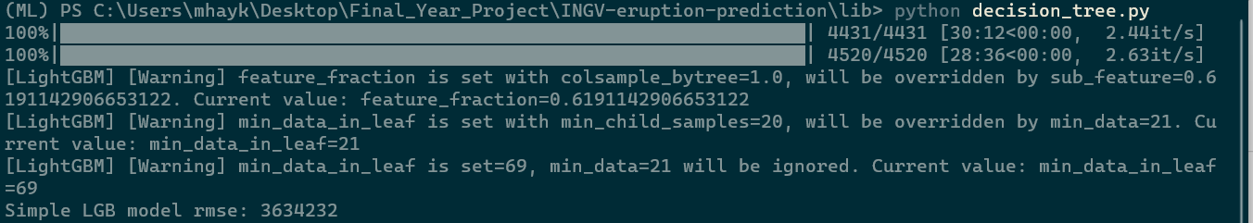
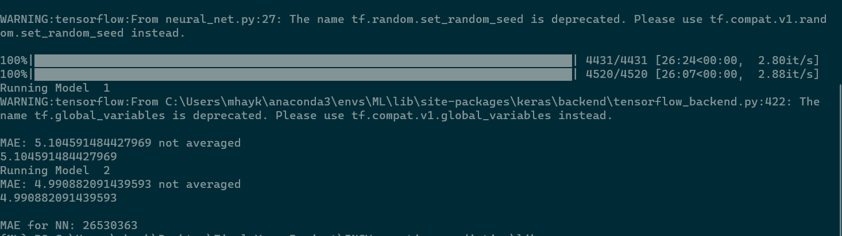
IV
Model Result
MAE:
Mean Absolute Error is the magnitude of difference between the prediction of an observation and the true value of that observation
MAE: 3634232
Decision Tree
Neural Network
MAE for NN: 26530363

Slide 10



Thank You

